Slide 1
TRAINING PROGRAM ON POST HARVEST MANAGEMENT OF CEREALS (MAIZE)
KOFI BOAKYE-FOSUHENE
(REGIONAL AGRIC. ENGINEER, B/A)

Slide 2
TRAINING ON POST HARVEST MANAGEMENT
This training is intended to be a guide for extension workers to understand post-harvest issues concerning grains and, therefore, be able to advise farmers.
For the purpose of this training the term grain is used to include cereals (maize, sorghum, millet, wheat and rice).
The term pulse refers to all kinds of legumes such as beans and peas.

Slide 3
The training is divided four (4) into main sections
The first section describes the role of the extension worker in obtaining information regarding the specific problems faced by farmers and how to share and impart knowledge,
The second section deals with the major causes of deterioration such as moulds, insects and rodents, and how to prevent and control these losses,
The third section describes traditional and improved types of storage,
The final section provides general recommendations for good storage practice.

Slide 4
Obtaining Information
The responsibility for providing advice and information to farmers rests ultimately with the field extension workers.
There are several stages in the advice process, including:
• identifying the problems;
• prioritising the problems;
• finding out what the farmer really wants to achieve; and
• providing appropriate solutions.

Slide 5
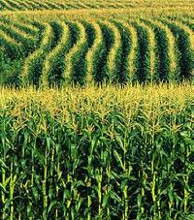
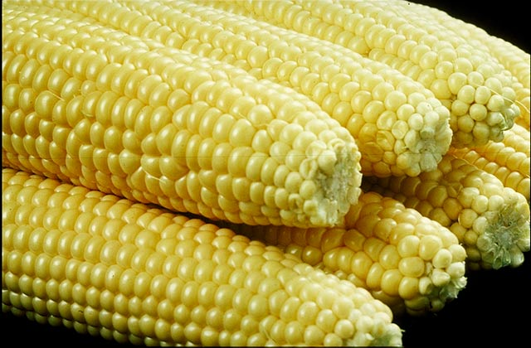
HEALTHY MAIZE FARMING, A FARMERS DESIRE

Slide 6
Major causes of deterioration, Prevention and Control of Grains
The extension worker’s job is to help the farmer keep the quality of the stored grain in the
best possible condition so that the best price can be obtained at sale.
The causes of quality loss are:
• insects
• moulds
• rodents
• birds

Slide 7
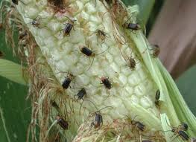
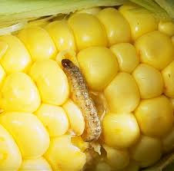
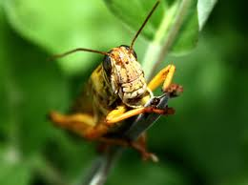
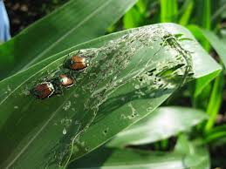
Insects

Slide 8
Insects
Insects are usually the most serious storage pests.
Nevertheless, insect damage reduces the quality of the grain and therefore the market price.
Insects cause loss in weight and also in the nutrient content.
Insect developing in grain produce heat, moisture and waste products.
This can create conditions suitable for further deterioration, especially the growth of moulds.

Slide 9
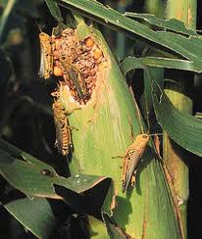
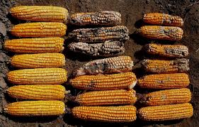
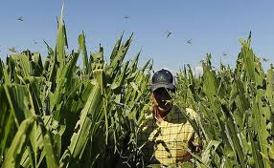
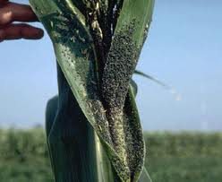
WHAT INSECTS CAN DO

Slide 10
Controlling methods of insects in stored cereals and pulses
Control methods can be divided into two groups:
Non-chemical methods of insect control are broadly considered to include any method that does not involve the use of conventional insecticides. They include traditional techniques employed by farmers.

Slide 11
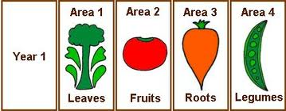
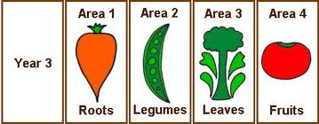
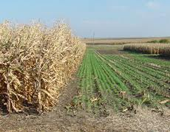
CROP ROTATION

Slide 12
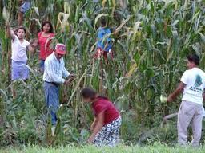
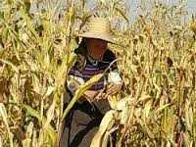
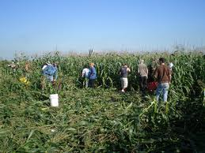
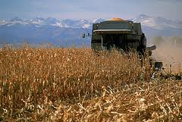
EARLY HARVESTING

Slide 13
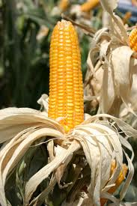
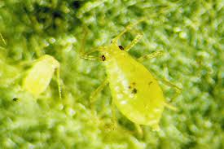
SOLARIZATION

Slide 14
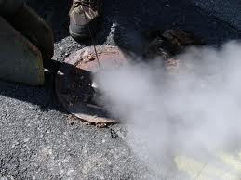
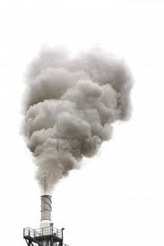
SMOKING

Slide 15
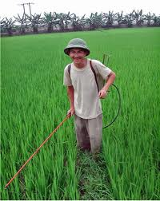
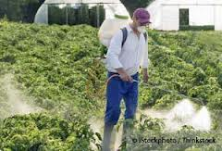
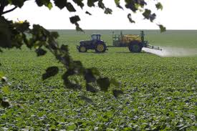
Chemical methods of insect control (insecticides)

Slide 16
Chemical methods of insect control (insecticides)
Insecticides, when properly applied to stored cereals and pulses as dusts or sprays can offer long-term protection against insect attack.
Insecticides are usually applied to dry threshed grain.
This minimizes the amount of insecticide required and provides good protection.

Slide 17
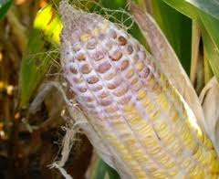

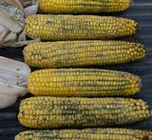
Moulds

Slide 18
Moulds
Moulds are growths that develop inside and on the surface of grains that have not been dried properly or become wet during storage.
They can be recognized as white, grey, black or green discolouration on the grain surface.

Slide 19
Other signs of the presence of moulds
• dustiness of grain;
• caking of grain;
• feed refusal by animals for no apparent reason;
• a bad musty (mouldy) smell;
• darkening of feed grain.

Slide 20
Factors that affect mould growth
• Moisture content of the grain; moulds require water for growth, so if the crop is well dried (below 13% for cereals and 7% for groundnuts), moulds will not be able to grow.
• climatic conditions; hot and humid conditions promote mould growth.
• field damage caused by insects, birds, rodents, and poultry (moulds can quickly infect grain through holes and cracks made by pests);
• plant stress caused by drought, infertile soil and even untimely or excessive fertilizer application (allows plants and seed to crack and become exposed to invading moulds and insects).

Slide 21
Con’t
• Maize cobs, sorghum and millet heads and pods of pulses that fall to the ground and come into contact with mould spores that live in the soil.
• Repeated planting of a crop in the same field may increase the risk of infection by mould.
• Poor handling at harvest, during drying, threshing and transportation can cause damage to grain, rendering it susceptible to attack by mould spores.
• Insect infestation in store (insect respiration produces water, which raises the moisture content of the grain allowing moulds to develop).

Slide 22
Prevention and control of Mould growth
The most effective way of preventing mould growth is to dry the grain as quickly as possible to a moisture content that is low enough for safe storage.
Safe storage is achieved when moulds cannot develop.
For cereals and pulses in tropical and subtropical countries this point is achieved when the moisture content is below 13-14 percent, for groundnuts and other oilseeds below 7 percent.

Slide 23
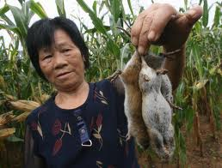
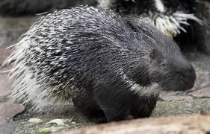
Rodents
Rats and mice damage storage containers, eat some of the stored produce, carry some away to their nests and spoil much more with droppings, urine and hairs. They usually spoil more than they actually eat.

Slide 24
Rodent control
The most effective method of preventing rodent damage is to keep the store clean and tidy and to have rodent proofing in place.
Rats and mice will stay in a store only if they can get food easily and find somewhere to
make a nest.
The area around the store must be kept clean.

Slide 25
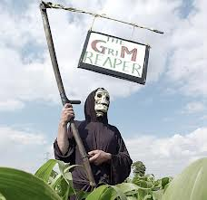
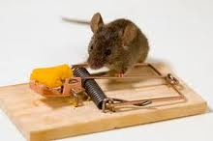
Rodent control

Slide 26
Birds
Some species of birds commonly feed on stored grain.
Birds can consume large amounts of grain.
They also contaminate the grain with their droppings and feathers.

Slide 27
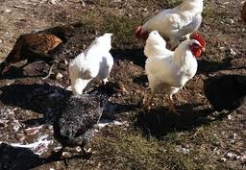
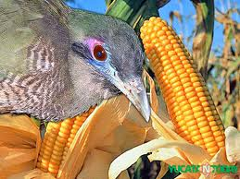
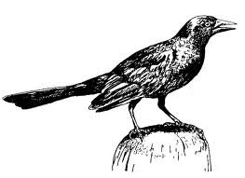
Birds

Slide 28
Birds control
Damage and loss of stored grain can be reduced by preventing birds from entering the store.
The store should be kept in good condition and the entrance or door to the store kept closed.
The area around the store and compound should be kept clean as birds are attracted by spilled grain.

Slide 29

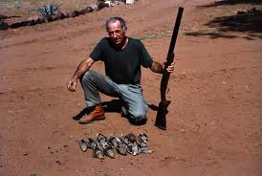
Birds control

Slide 30
Storage Methods
Traditional methods of storage have evolved over long periods and many generations and are usually well suited to the climatic and social environment in which they are used.

Slide 31
Seed storage
Many farmers retain their own seed each year. Soon after harvest, seed grain is selected from the crop that has just been brought home.
Any reduction in the quality of seed, such as insect and mould damage and shrivelling through water loss or heat exposure, will reduce the germination potential and therefore reduce the size of the next crop.

Slide 32
Food Grain Storage
The commonly used methods for storing grains are described below..
Platforms and frames
Platforms constructed in the open may be four-cornered or circular racks made from timber, bamboo or sisal poles. They are usually raised on legs about 1.5 m above the ground. Cereals and pulses are stored unthreshed in heaps or in regular stacks.

Slide 33
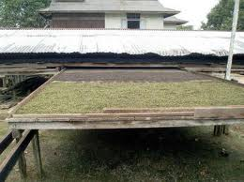
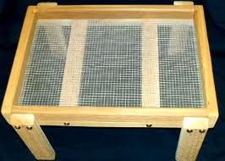
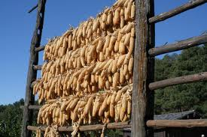
Platforms and Frames

Slide 34
Drying and storage cribs
Traditional cribs are circular or rectangular with a framework of wooden poles. Ideally, the width of the crib should not exceed:
• 0.6 m in humid areas where maize is harvested at high moisture content (30-35
percent);
• 1.0 m in dryer zones with a single rainy season where maize is harvested with about
25 percent moisture content;
• 1.5 m in very dry places.

Slide 35
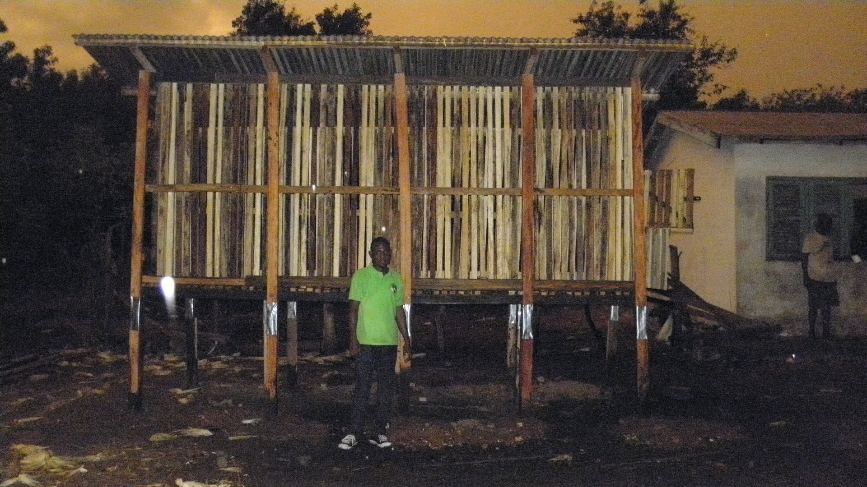
Crib constructed at Ayakomaso

Slide 36
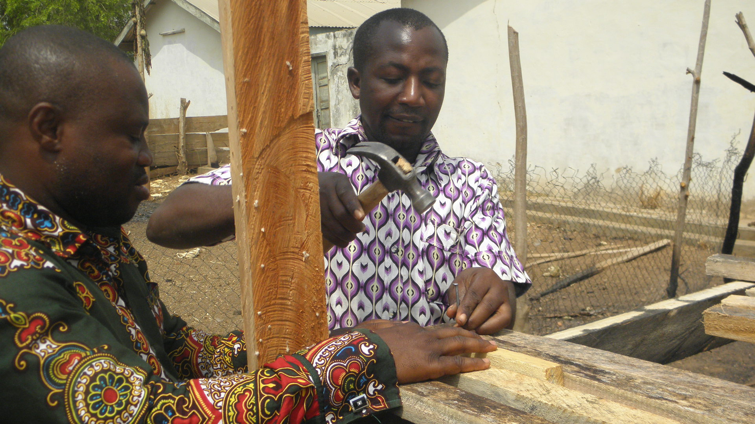
Crib constructed at Ayakomaso

Slide 37
Baskets
Baskets with an open weave are suitable for drying grain, e.g. sorghum heads and maize cobs, especially without husks.
Dry, shelled grain can be stored in close-weave baskets or baskets that have mudded walls.

Slide 38
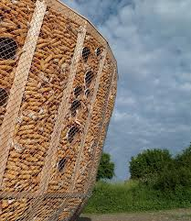
Basket

Slide 39
Solid wall bins
Solid wall bins may be spherical, cylindrical or rectangular in shape. Designs are often characteristic of communities or localities. The bins may be made of clay (sometimes strengthened by mixing with straw or twigs) or clay blocks or burnt bricks.

Slide 40
Metal storage bins
Metal storage bins are made from smooth or corrugated galvanized metal sheets.
They are usually cylindrical in shape with a flat top and bottom. Most bins are used for small-scale storage.
Have a capacity of up to 1 tonne.

Slide 41
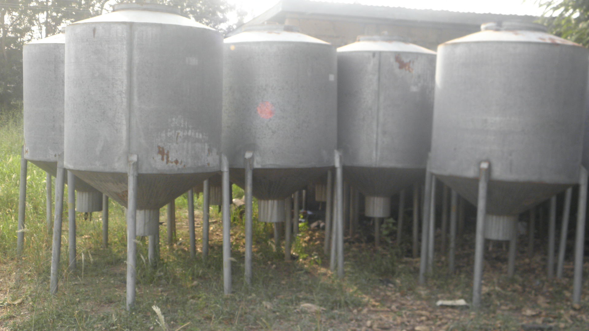
Metal storage bins

Slide 42
Underground storage
Pit stores are used in some parts of Africa, the Middle East and Southern Asia, primarily for storage of sorghum, millet and small grain pulses.
The best pit stores provide a reliable, hermetic method of long-term storage.

Slide 43
Bag storage
Bag storage is a convenient way of keeping threshed grain and pulses.
The need to thresh or shell grain may deter farmers from using bags if labour is in short supply at harvest time.

Slide 44
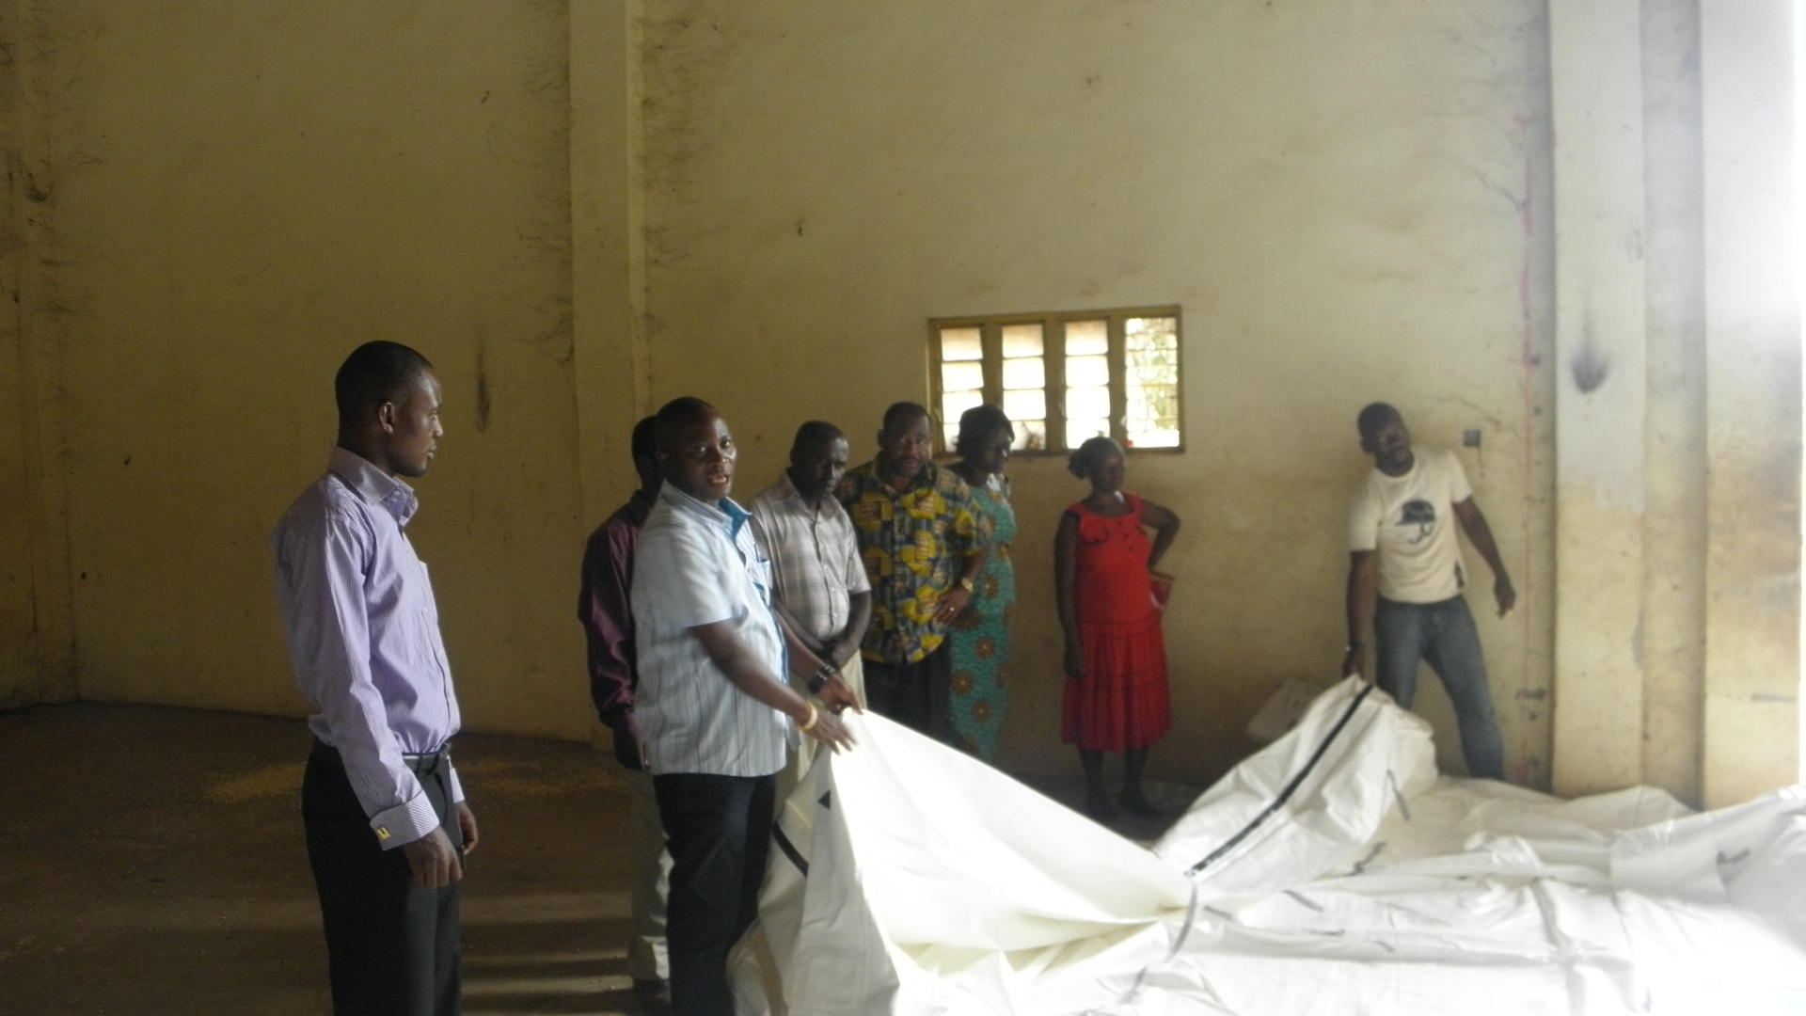
Grain Prococoon

Slide 45
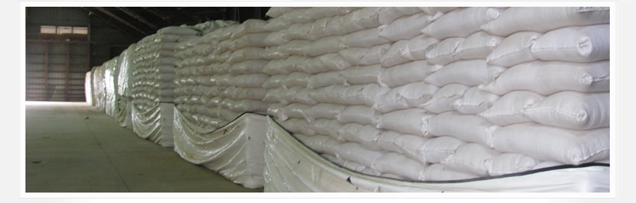
Grain Prococoon

Slide 46
Good storage practice
If grain is to remain in good condition from harvest to the time that it is to be consumed or sold, the farmer must follow the four pillars of good storage practice.

Slide 47
The Four (4) Pillars of Good Storage
• Ensuring that the crop going into store is in good condition.
• Keeping the store in good condition.
• Practising good store hygiene.
• Maintaining the condition of crop and store throughout the storage season.

Slide 48
MOFA-RADU, ENGINEERING
THANKS FOR YOUR ATTENTION

